Slide 1
21CSS201T COMPUTER ORGANIZATION AND ARCHITECTURE UNIT-2 Topic : Instruction and Instruction Sequencing

Slide 2
Introduction
Instruction: is a command to the microprocessor to perform a given task on specified data.
Mov sta add mul div
Instruction Set: The entire group of these instructions are called instruction set.
instruction sequencing : The order in which the instructions in a program are carried out.

Slide 3
TYPES OF OPERATIONS
A computer must have instructions capable of performing 4 types of operations
Data transfer between memory and processor register
Arithmetic and logic operation
Program sequencing and control
I/O transfer

Slide 4
Register transfer notation (RTN)
Transfer of information from one location in computer to another.
Transfer between processor registers & memory, between processor register & I/O devices
Memory locations, registers and I/O register names are identified by a symbolic name in uppercase alphabets
LOC,PLACE,MEM are the address of memory location
R1 , R2,… are processor registers
DATA_IN, DATA_OUT are I/O registers
Contents of location is indicated by using square brackets [ ]
Eg. (R1←[LOC], R3 ←[R1]+[R2])

Slide 5
Register transfer notation (RTN) …
RHS of RTN always denotes a value, and is called Source
LHS of RTN always denotes a symbolic name where value is to be stored and is called destination
Source contents are not modified
Destination contents are overwritten
Note: In instructions, like Move LOC, R1 (Unlike RTN), LOC is Source and R1 is Destination.
Eg 2: Add R1, R2, R3 (R1+R2 is placed in the destination R3)

Slide 6
Examples of RTN statements
R2 [LOCN]
R4 [R3] +[R2]

Slide 7
Types of Instructions Based on their functions
Based on the functions performed instructions are classified into 5 types:
Data transfer Instructions
Data Manipulation Instructions
Arithmetic Instructions
Logical and bit manipulation instructions
Shift instructions

Slide 8
Data transfer Instructions
They are also called copy instructions.
Some instructions in 8086:
MOV -Copy from the source to the destination
LDA - Load the accumulator
STA - Store the accumulator
PUSH - Push the register pair onto the stack
POP - Pop off stack to the register pair

Slide 9
Data Manipulation Instructions
To perform the operations by the ALU
Three categories:
Arithmetic Instructions
Logical and bit manipulation instructions
Shift instructions

Slide 10
Arithmetic Instructions
Used to perform arithmetic operations
Some instruction in 8086
INC ➔ Increment the data by 1
DEC ➔ Decreases data by 1
ADD ➔ perform sum of data
ADC ➔ Add with carry bit.
MUL ➔ perform multiplication

Slide 11
Logical and bit manipulation instructions
Used to perform logical operations
Some instructions are:
AND ➔ bitwise AND operation
OR ➔ bitwise OR operation
NOT ➔ invert each bit of a byte or word
XOR ➔ Exclusive-OR operation over each bit

Slide 12
Shift instructions
used for shifting or rotating the contents of the register
Some instructions are:
SHR ➔ shift bits towards the right and put zero(S) in MSBs 0010 0001
ROL ➔ rotate bits towards the left, i.e. MSB to LSB and to Carry Flag [CF]
RCL ➔ rotate bits towards the left, i.e. MSB to CF and CF to LSB.

Slide 13
Instruction Formats (Types of instruction based on the address field)
A instruction in computer comprises of groups called fields.
These field contains different information
The most common fields are:
Operation field : specifies the operation to be performed like addition.
Address field : contain the location of operand
Mode field : specifies how to find the operand

Slide 14
Instruction Formats (Types of instruction based on the address field) …
A instruction is of various length depending upon the number of addresses it contain.
On the basis of number of address, instruction are classified as:
Zero Address Instructions
One Address Instructions
Two Address Instructions
Three Address Instructions

Slide 15
Zero Address Instructions
Used in stack based computers which do not use address field in instruction
Location of all operands are defined implicitly
Operands are stored in a structure called pushdown stack
Operation

Slide 16
Zero Address Instructions …
If processor supports ALU operations one data in memory and other in register then the instruction sequence is
MOVE D, Ri
ADD E, Ri ; Ri=Ri+E
MOVE Ri, F
If processor supports ALU operations only with registers then one has to follow the instruction sequence given below
LOAD D, Ri
LOAD E, Rj
ADD Ri, Rj
MOVE Rj, F

Slide 17
Example: Evaluate (A+B) ∗ (C+D)
Using Zero-Address instruction
PUSH A ; TOS ← A
PUSH B ; TOS ← B
ADD ; TOS ← (A + B)
PUSH C ; TOS ← C
PUSH D ; TOS ← D
ADD ; TOS ← (C + D)
MUL ; TOS ← (C+D)∗(A+B)
POP X ; M[X] ← TOS

Slide 18
One address Instruction
Syntax- Operation source/destination
In this type either a source or destination operand is mentioned in the instruction
Other operand is implied to be a processor register called Accumulator
Eg: ADD B (general)
Load D; ACC [memlocation _D]
ADD E; ACC (ACC) +(E)
STORE F; memlocation_F (ACC )

Slide 19
One address Instruction
This use a implied ACCUMULATOR register for data manipulation.
Operation Destination
One operand is in accumulator and other is in register or memory location.
Example: Evaluate (A+B) ∗ (C+D)
Using One-Address Instruction
LOAD A ; AC ← M[A]
ADD B ; AC ← AC + M[B]
STORE T ; M[T] ← AC
LOAD C ; AC ← M[C]
ADD D ; AC ← AC + M[D]
MUL T ; AC ← AC ∗ M[T]
STORE X ; M[X] ← AC

Slide 20
Two address Instruction
Syntax : Operation source, destination
Eg: MOVE E,F MOVE D,F
ADD D,F OR ADD E,F
Perform ADD A,B,C using 2 instructions
MOVE B,C
ADD A,C
Disadvantage: Single instruction is not sufficient to perform the entire operation.

Slide 21
Two Address Instruction
This is common in commercial computers.
Operation Source, Destination
Here two address can be specified in the instruction.
Example: Evaluate (A+B) ∗ (C+D)
Using Two address Instruction:
MOV R1,A ; R1=M[A]
ADD R1,B ;R1=R1+M[B]
MOV R2,C ;R2=M[C]
ADD R2,D ;R2=R2+M[D]
MUL R1,R2 ; R1=R1*R2
MOV X,R1 ; M[X]=R1

Slide 22
Three Address Instruction
Syntax: Operation source 1, source 2, destination
Eg: ADD D,E,F
where D,E,F are memory location
Advantage: Single instruction can perform the complete operation
Disadvantage : Instruction code will be too large to fit in one word location in memory

Slide 23
Three Address Instruction
This has three address field to specify a register or a memory location.
Program created are much short in size
creation of program much easier
does not mean that program will run much faster
Example: Evaluate (A+B) ∗ (C+D)
Using Three address Instruction
ADD R1,A,B ;R1=M[A]+M[B]
ADD R2,C,D ;R2=M[C]+M[D]
MUL X,R1,R2 ;M[X]=R1*R2

Slide 24
Instruction Cycle
the basic operational process of a computer.
also known as fetch-decode-execute cycle
This process is repeated continuously by CPU from boot up to shut down of computer.
Steps that occur during an instruction cycle:
1. Fetch the Instruction
2. Decode the Instruction 3. Read the Effective Address
4. Execute the Instruction

Slide 25
Instruction Cycle …
1. Fetch the Instruction
The instruction is fetched from memory address that is stored in PC(Program Counter) and stored in the (instruction register) IR.
At the end of the fetch operation, PC is incremented by 1 and it then points to the next instruction to be executed.
2. Decode the Instruction
The instruction in the IR is decoded(Interpreted).
3. Read the Effective Address
If the instruction has an indirect address, the effective address is read from the memory.
Otherwise operands are directly read in case of immediate operand instruction.

Slide 26
Instruction Cycle …
4. Execute the Instruction
The Control Unit passes the information in the form of control signals to the functional unit of CPU.
The result generated is stored in main memory or sent to an output device.
The cycle is then repeated by fetching the next instruction.
Thus in this way the instruction cycle is repeated continuously.

Slide 27
Instruction execution and straight line sequencing
Instruction execution needs the following steps, which are
PC (program counter) register of the processor gives the address of the instruction which needs to be fetched from the memory.
If the instruction is fetched then, the instruction opcode is decoded. On decoding, the processor identifies the number of operands. If there is any operand to be fetched from the memory, then that operand address is calculated.
Operands are fetched from the memory. If there is more than one operand, then the operand fetching process may be repeated (i.e. address calculation and fetching operands).
After this, the data operation is performed on the operands, and a result is generated.
If the result has to be stored in a register, the instructions end here.
If the destination is memory, then first the destination address has to be calculated. Then the result is then stored in the memory. If there are multiple results which need to be stored inside the memory, then this process may repeat (i.e. destination address calculation and store result).
Now the current instructions have been executed. Side by side, the PC is incremented to calculate the address of the next instruction.
The above instruction cycle then repeats for further instructions.

Slide 28
Straight line sequencing
Straight line sequencing means the instruction of a program is executed in a sequential manner(i.e. every time PC is incremented by a fixed offset).
And no branch address is loaded on the PC.

Slide 29
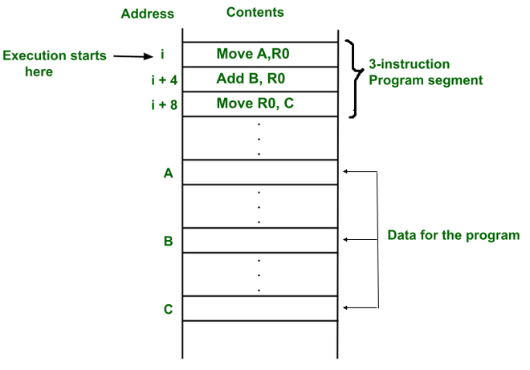
Straight line sequencing …
Example 1: A Program for C <- [A] + [B]
Programs and data are stored in the same memory, i.e. von Neumann architecture.
First instruction of a program is stored at address i.
PC gives address i and instruction stored at that address i is fetched from the memory and then decoded and then operand A is fetched from the memory and stored in a temporary register and then the instruction is executed (i.e. content of address A is copied into processor register R0)
The PC gets incremented by 4 (i.e. it contains the address of the next instruction) because the instruction and memory segment is of 4 bytes.
So the instruction at address i+4 is executed now. i.e, B is added to R0.
The PC gets incremented by 4 (i.e. it contains the address of the next instruction)
So the instruction at address i+4 is executed now. i.e. The result in R0 is copied to C.
So every time, the PC is incremented by 4. Therefore, the program is executing in a sequential manner. And this process is called straight line sequencing.

Slide 30
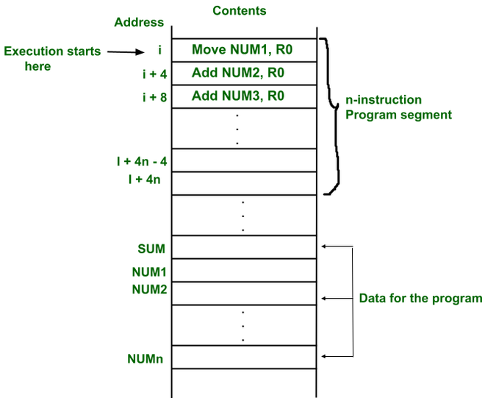
A Straight line program for adding n numbers
The addresses of the memory locations containing the n numbers are represented as NUM1,NUM2…..NUMn (i.e. NUM1 address includes first number).
The first number is stored into processor register R0. And every other number is added to register R0. Finally, when the program ends(i.e. n numbers are added, the result is placed in memory location SUM

Slide 31
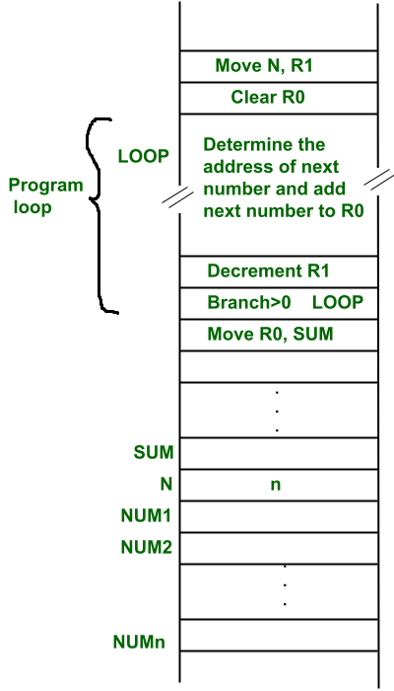
Using a loop to add n numbers
The second way is to use a loop to add n number. But here straight line sequencing is not used because every time loop iteration ends, PC has to load the branch address and program execution starts from that address.
Here the location N stores the value of n.
Processor register R1 is used as a counter to determine the number of times the loop gets executed.
The contents of the location N are moved into R1 at the start of program execution.
After that, register R0 is cleared.
The address LOOP is reloaded again and again until R1 becomes 0.
Every time a number is added, then the R1 value is decremented.
When R1 becomes 0, we come out of the loop and the result which is stored at R1 is copied into memory location SUM.

Slide 32
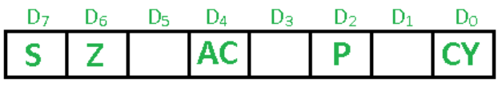
Condition Codes
The processor keeps track of information about the results of various operations for use by subsequent conditional branch instructions
N – Negative 1 if results are Negative
0 if results are Positive
Z – Zero 1 if results are Zero
0 if results are Non zero
V – Overflow 1 if arithmetic overflow occurs
0 non overflow occurs
C – Carry 1 if carry and from MSB bit
0 if there is no carry from MSB bit

Slide 33
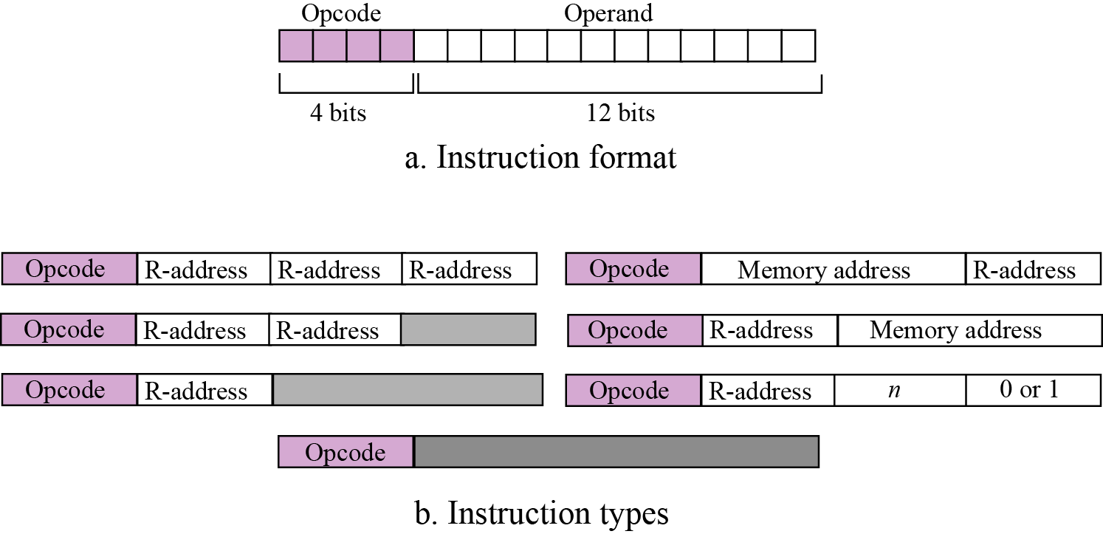
Format and different instruction types

Slide 34
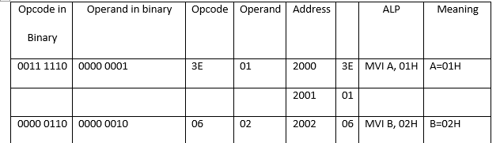
Assembly language instruction MVI R in 8085 with opcode 00rrr110

Slide 35
Processing the instructions
Computers generally use machine cycles.
A cycle is made of three phases:
Fetch
Decode and
Execute.

Slide 36
Fetch phase
During the fetch phase, the instruction whose address is determined by the PC (Program Counter) is obtained from the memory and loaded into the IR (Instruction Register).
The PC is then incremented to point to the next instruction.

Slide 37
Decode phase
During the decode phase, the instruction in IR is decoded and the required operands are fetched from the register or from memory.

Slide 38
Execute phase
During the execute phase, the instruction is executed and the results are placed in the appropriate memory location or the register.
Once the third phase is completed, the control unit starts the cycle again, but now the PC is pointing to the next instruction.
The process continues until the CPU reaches a HALT instruction.

Slide 39
Flow chart for Instruction Execution
start
Load address to PC
Load content of PC to IR
Update PC to next address
Execute Instruction
Interrupts
Service Interrupt

